Slide 1
CS 4530: Fundamentals of Software Engineering Module 6, Lesson 4 Organizing Humans to Build Software
Rob Simmons
Khoury College of Computer Sciences

Slide 2
Top-Down and Bottom-Up Organization
Eric S Raymond’s 1997 essay compares software development methodologies as a “cathedral” or “bazaar”
Many “free software” projects are designed top-down
Prototypical “bazaar” example was Linux development, bottom-up and over the internet
Notes:
Part of Linux’s successes and growth in the 90’s is captured in Eric S. Raymond’s 1997 essay “The cathedral and the bazaar”
Cathedral (closed source) - Top-down design with focus on planning
Bazaar (open source)
Organic bottom-up movement
Code always public over internet

Slide 3
Top-Down and Bottom-Up Organization
Notes:
Elm – very cathedral
Python — translated to

Slide 4
Successful OSS have strong communities
OS projects thrive when community surrounding them contributes to push the project forward
Communities form around collective ownership (even if it’s only perceived)
Contributors bring more than code: also documentation, support, and outreach
Community/ownership models:
Corporate owner, community outreach/involvement (MySQL, MongoDB)
Foundation owner, corporate sponsors (GNU, Linux)

Slide 5
Other philosophies are expressed in some licenses
Notes:
Remember how the SQLite license had a *blessing* “May you do good not evil?”
Some people try to be a bit more outright, like: “You can not use this software for evil.” Here’s a clip from the guy that created JSON (and JSLint, a popular tool used by everyone to validate JSON)

Slide 6
OSS and JSLint → ESLint
JSLint was written by Douglas Crockford for checking if JavaScript source code complies with coding rules (2002)
Original License: MIT with modification
Changed to FSF / OSI approved “Unlicense” license (public domain) – 2021
Anton Kovalyov forked it to create JSHint (2011)
Nicholas C. Zakas created ESLint (2013), where all rules are configurable, and additional rules can be defined or loaded at run-time (Zakas worked on JSHint project)
Palantir developed TSLint (2013) which was later deprecated
Marat Dulin created JSCS (2014). In 2016, the JSCS Team joined the ESLint project and has since discontinued maintenance of the JSCS tool.
OSS development methodology lives on …
Notes:
<read slide>

Slide 7
Open Source Software Creates Value
…who gets to profit off of that value?
…how does everyone else live?

Slide 8
“Open Source as a Utility” is a common model
The largest, most successful open source projects implement utility infrastructure:
Operating systems, web servers, logging libraries, programming languages
Business model: build and sell products and services using those utilities, contribute improvements back to the ecosystem
Linux, Kubernetes, React, etc.
Many companies provide specialized distributions of these open source infrastructure and specialized tools to improve them; support upstream project
Notes:
Example: bank needs to have servers, bank might need to have linux. Does bank have staff to support and patch linux, or do they pay someone for a service contract? They pay Red Hat (recently purchased by IBM, about 20 years after that ad was made).
We all love and hate Java; we probably use IDEs from JetBrains ,who also is involved in the ongoing maintenance of java, and created the JVM-compatible language, kotlin
Discussion: Are there other projects that you can think of that are open source, and not really what the company who created them does? How do those companies (in)directly profit from this?
React (Facebook is a social network, but created and maintains an app toolkit) - profits from apps that integrate with their network
Square, many other small-ish tech companies open source their dev tools and libraries - helps with recruiting?

Slide 9
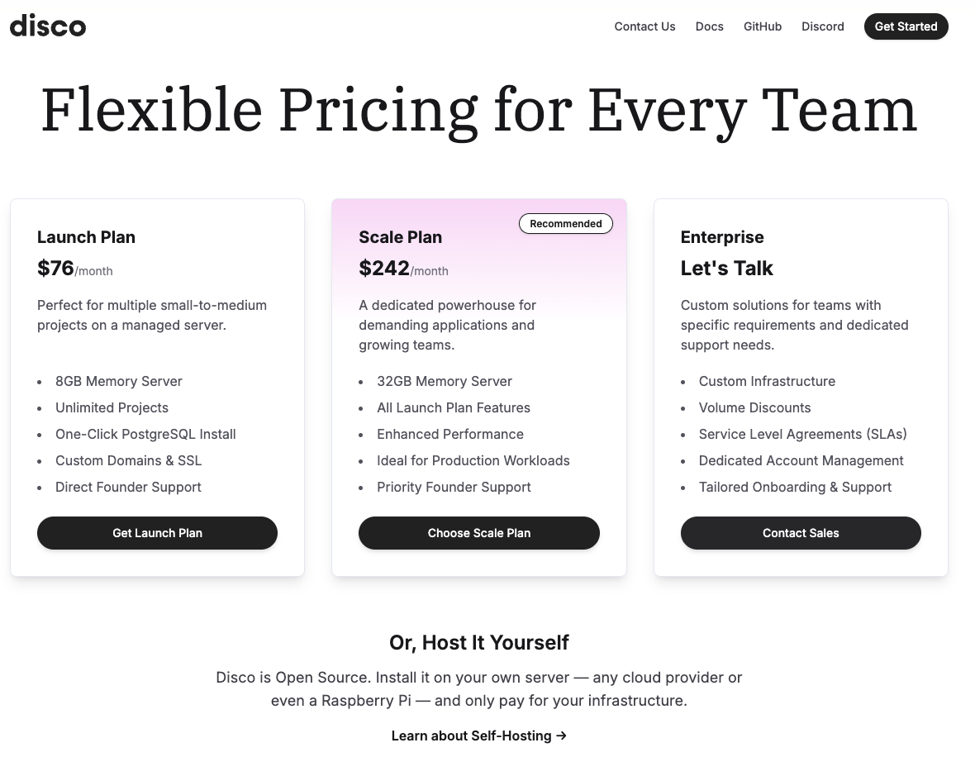
Cloud services make this easier… and harder
Many companies offer PaaS/SaaS hosted versions of their OS offerings to pay for continued development.
But AWS can easily undersell those people… but long-term is reliant on them!

Slide 10
Monetize OSS by offering title insurance
SQLite is an extremely popular database library, in the public domain (copyright is waived)
To have legal proof that the code is in the public domain (traceable links from code to waivers of copyright), you pay money
Notes:
<read slide>

Slide 11
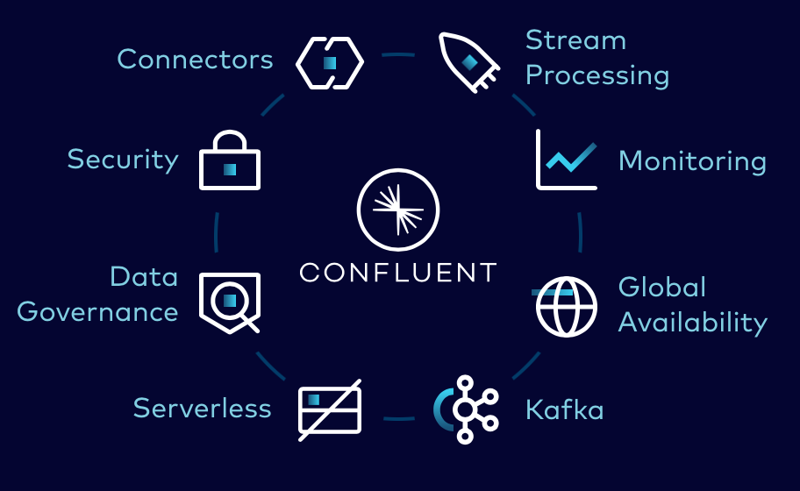
Monetize OSS with “open core, closed plugins”
Model: core component of product is open source; plugins for a fee
Example: Apache Kafka, a distributed message broker (glue in event-based system)
Product is open source, maintained by Apache foundation, supported by a company
Confluent provides plugins to connect Kafka to different systems out-of-the-box
[Screenshot: “Apache Kafka vs Confluent”]

Slide 12
Find a “Benevolent” Sponsor

Slide 13
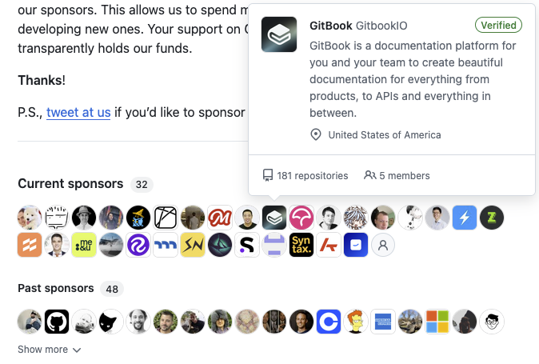
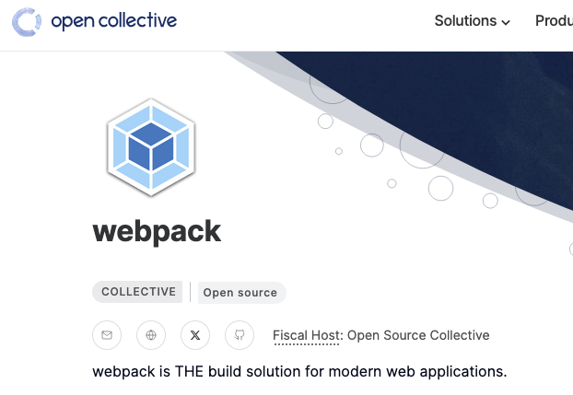
Find Lots of Benevolent Sponsors

Slide 14
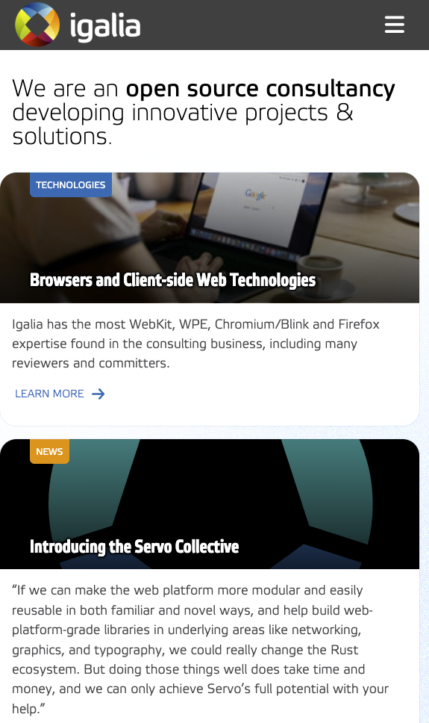
Open-source development for hire

Slide 15
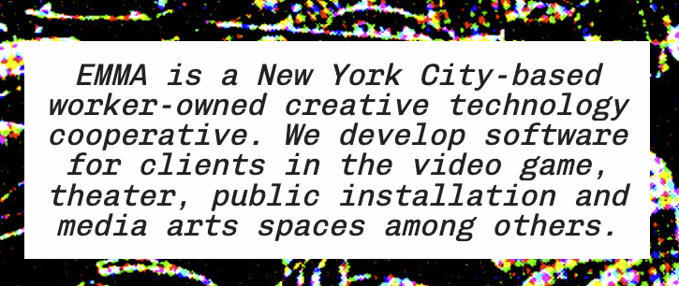
How do we pay people to build other kinds of software?

